Slide 1
Optimizing Power Consumption in Differential Amplifiers
SuperVisor Teacher :-
Dr. RishiBrind Upadhyay TEAM NAME :- Priyanshu Aggarwal A8 22102236 Harsheeta Agarwal A8 22102187

Slide 2
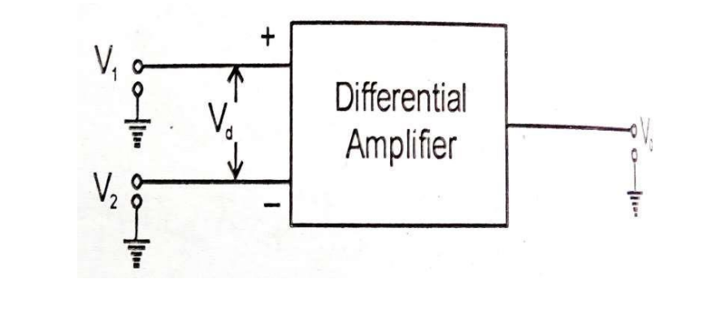

What is Differential Amplifier
A differential amplifier is a type of electronic amplifier that amplifies the difference between two input voltages while rejecting any signals common to both inputs.
Widely used in analog circuits, operational amplifiers, and sensor applications. It is also the basic input stage of an integrated amplifier.

Slide 3

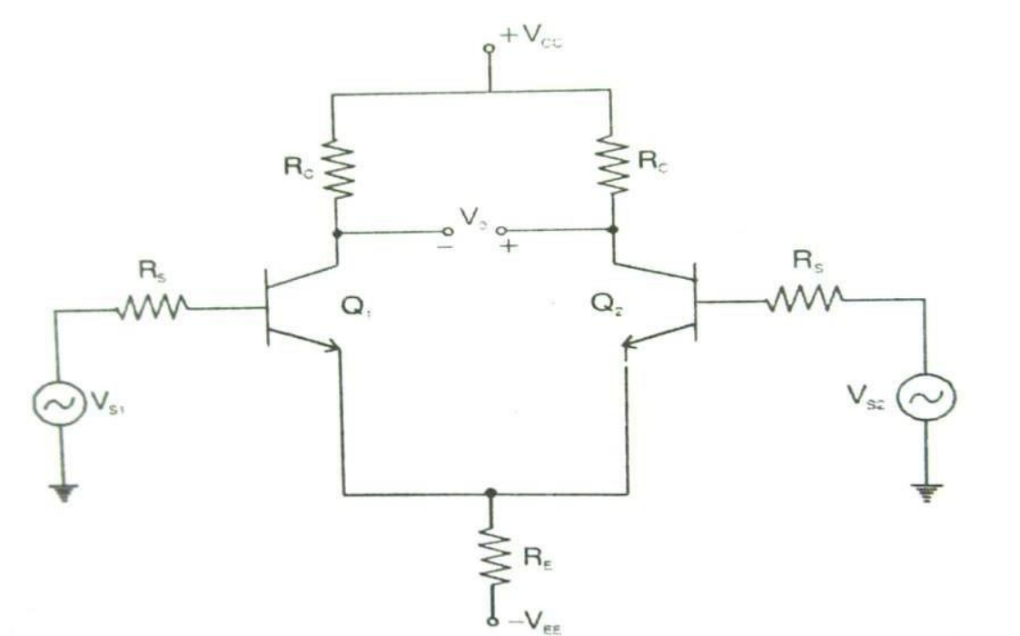
The output signal in a differential amplifier is directly proportional to the difference between the two input signals. Mathematically, it can be expressed as:
Vo​ ∝ (V 1​ −V 2​ ) Where:
V 1​ and V 2​ are the two input signals. V o​ is the single-ended output voltage.
Basic configuration of a differential amplifier

Slide 4
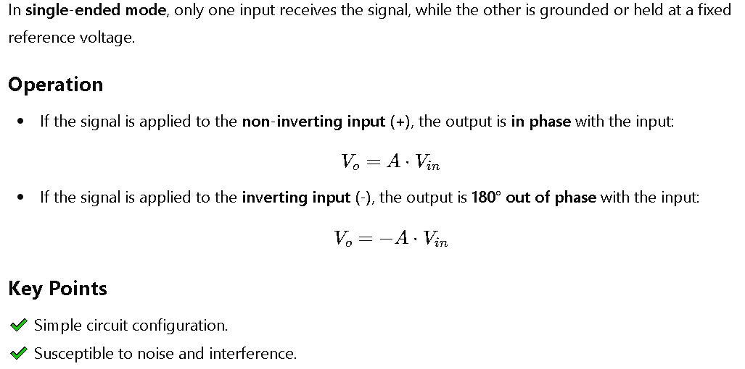
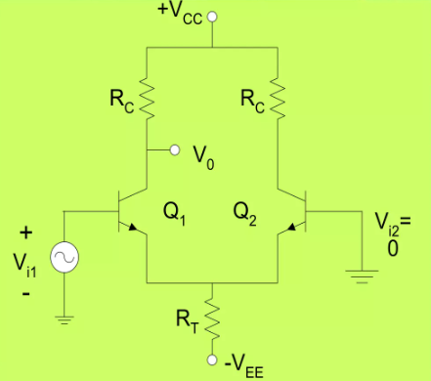
𝗦𝗶𝗻𝗴𝗹𝗲-𝗘𝗻𝗱𝗲𝗱 𝗠𝗼𝗱𝗲

Slide 5
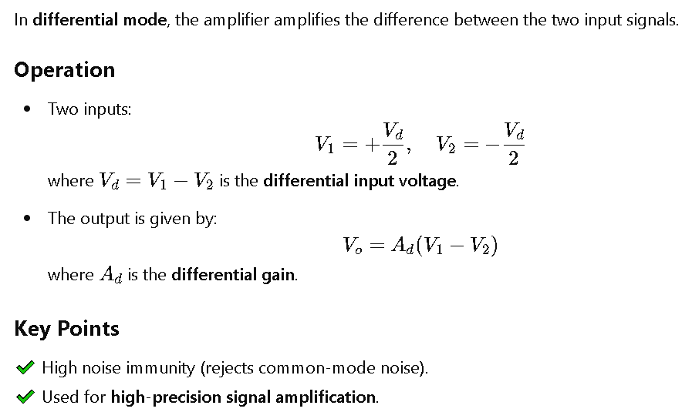
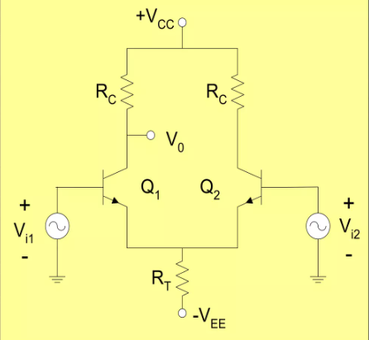
𝗗ifferential Mode

Slide 6
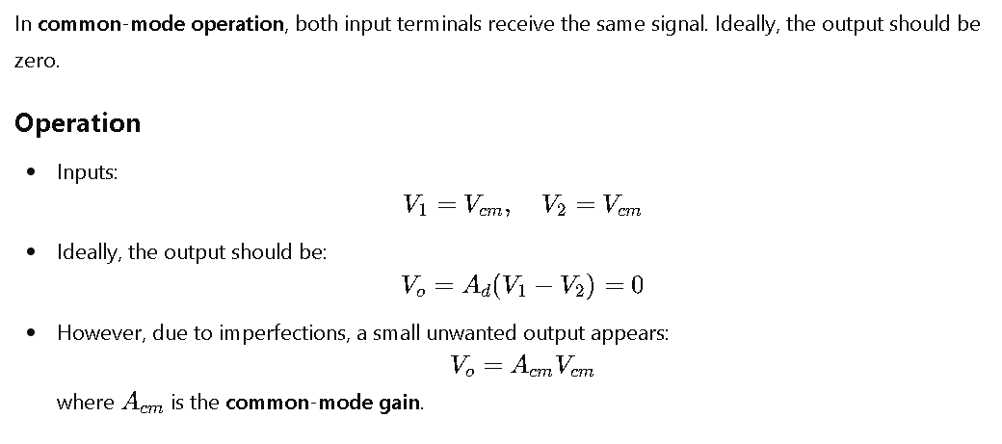
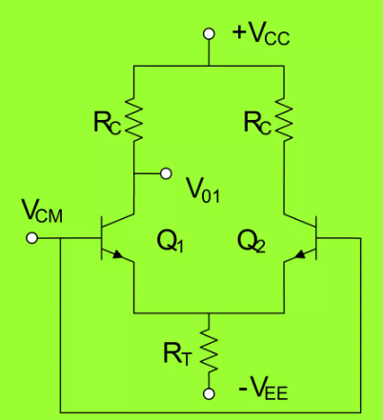

𝗖𝗼𝗺𝗺𝗼𝗻 𝗠𝗼𝗱𝗲

Slide 7

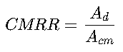
𝐂𝐨𝐦𝐦𝐨𝐧 𝐌𝐨𝐝𝐞 𝐑𝐞𝐣𝐞𝐜𝐭𝐢𝐨𝐧 𝐑𝐚𝐭𝐢𝐨
The ability of a differential amplifier to reject common-mode signals (unwanted noise or interference).
Defined as the ratio of differential gain to common-mode gain.
Mathematical Expression:
A_{d}​ = Differential gain A_{cm}​ = Common-mode gain
Key Points:
✅ Higher CMRR → Better noise rejection. ✅ Used in instrumentation amplifiers, biomedical applications (ECG, EEG), and communication systems. ✅ Ideally, CMRR should be infinite, but practical values range from 60 dB to 120 dB.

Slide 8
Differential Gain
Mathematical Expression:
V_{o}​ is the output voltage. V₁−V₂=V_{d} is the difference of the two input voltages (Differential Input). A_{d​} is the differential gain. A more detailed formula for differential gain is:
where:
G_{m} is the transconductance of the transistor.
R_{C} is the collector resistor.
V_{o}=A_{d}​(V₁​−V_{2​})
Differential Gain (Ad) is the gain with which the differential amplifier amplifies the difference between two input voltages (V₁ - V₂).
It represents how well the amplifier responds to the difference in signals applied at the two inputs.
A_{d}=V_{o}/V_{d}=−g_{m}R_{C}

Slide 9
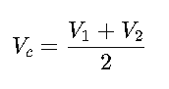
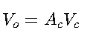
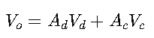
Common Mode Gain
Common Mode Gain (Ac) represents how much of the common part of the input signals is amplified by the differential amplifier.
If both input signals are equal, their average is called the common mode signal
Mathematical Expression:
Effect on Output Voltage:
Since the differential amplifier is not perfect, it also produces some output proportional to the common mode signal. The output due to common mode is given by:
Total Output Voltage of the Differential Amplifier:
Since the amplifier responds to both differential signals and common mode signals, the total output is given by:

Slide 10
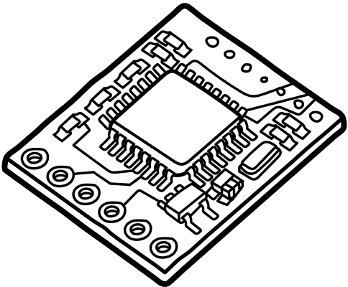
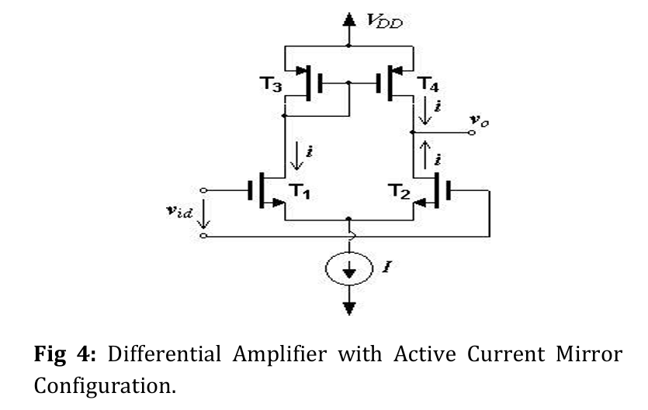
Circuits of Differential Amplifier

Slide 11
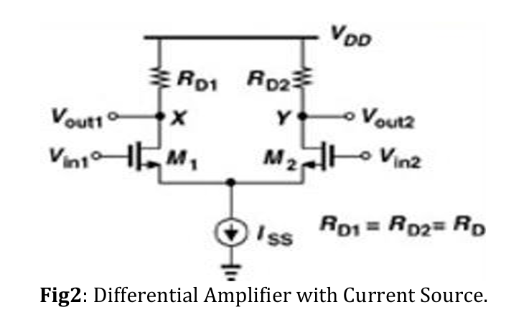
Circuits of Differential Amplifier

Slide 12
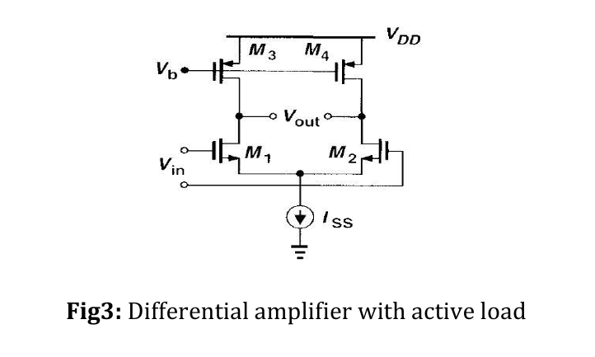
Circuits of Differential Amplifier

Slide 13
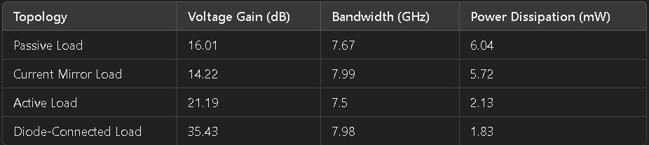
Comparison of Different Differential Amplifier Topologies

Slide 14
Impact of Different Load Configurations
Passive Load:
Uses resistors, leading to lower gain and higher power dissipation.
Simple to design but inefficient for low-power applications.
Current Mirror Load:
Improves current sourcing, leading to better gain stability.
Reduces power consumption but still limited in gain.
Active Load:
Uses MOSFET-based loads instead of resistors, significantly boosting gain.
Lower power dissipation, making it ideal for low-power VLSI applications.
Diode-Connected Load:
Provides highest gain but at the cost of reduced bandwidth.
Suitable for high-gain, low-frequency applications.

Slide 15
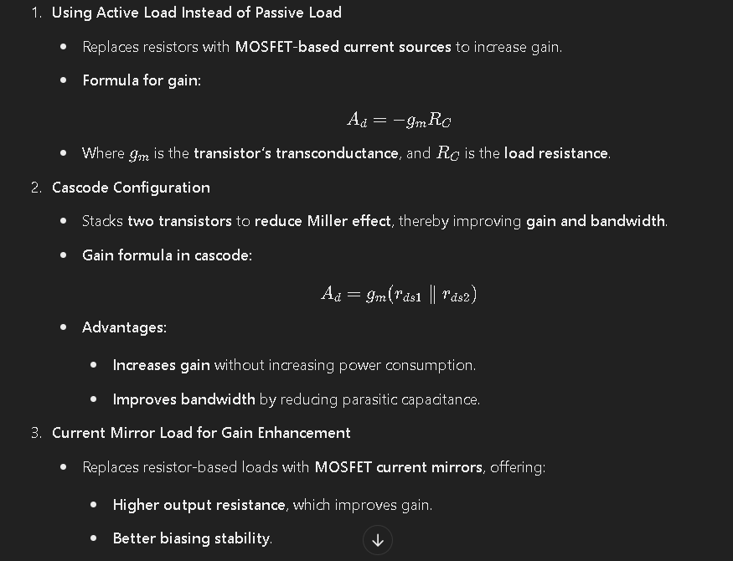
Enhancing Gain in Differential Amplifiers

Slide 16
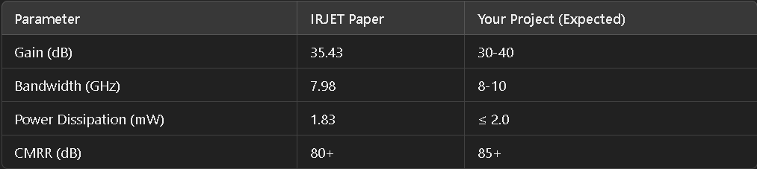
Simulation and Technology Used
Technology Details
Simulation Software: Cadence Virtuoso
Technology Node: 180nm CMOS Process
Supply Voltage: 1.8V
Simulation Types:
DC Analysis: To analyze operating point & biasing.
AC Analysis: To measure gain, bandwidth, and phase margin.
Transient Analysis: To observe time-domain signal behavior.
Comparison of Simulation Results -

Slide 17
Scope of the Project
Global Scope
Medical Electronics: Differential amplifiers are widely used in ECG, EEG, and biosignal amplifiers.
Consumer Electronics: Low-power designs are essential for smartphones, audio systems, and IoT devices.
Communication Systems: Differential amplifiers improve signal integrity in 5G and high-speed networks.

Slide 18
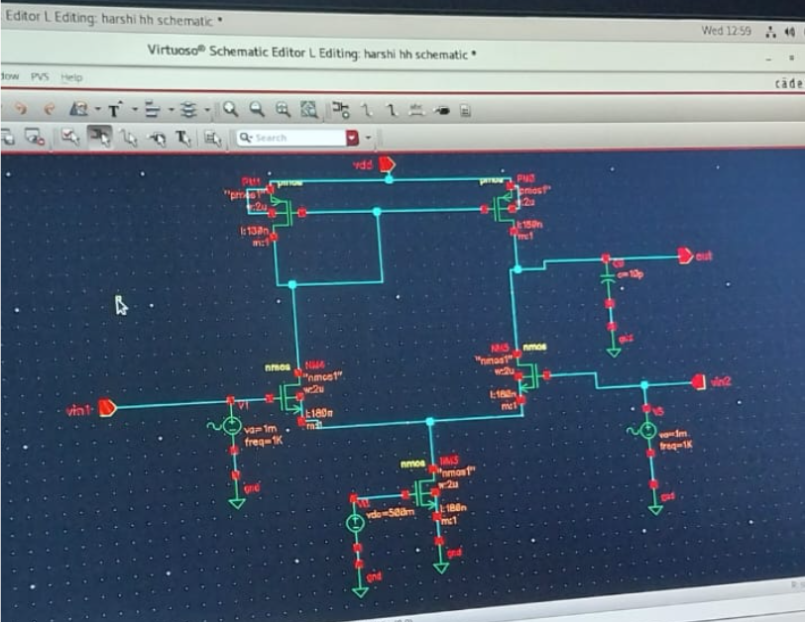
Active Load Circuit
CIRCUIT DIAGRAM OF ACTIVE LOAD DIFFERENTIAL AMPLIFIER

Slide 19
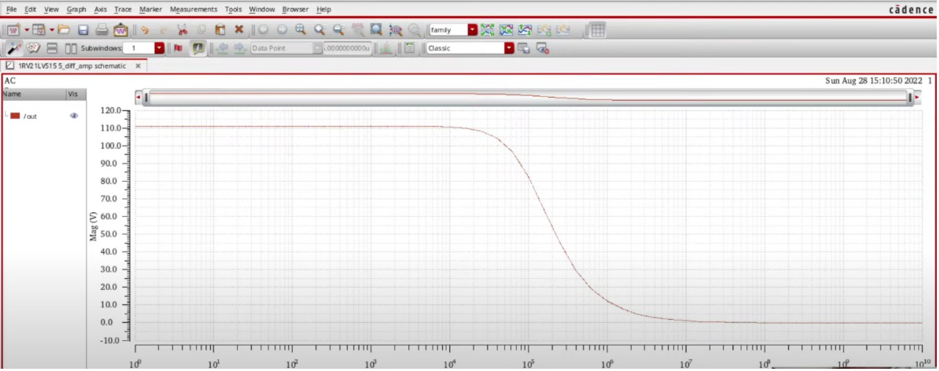
Active Load Circuit
V-F GRAPH OF ACTIVE LOAD DIFFERENTIAL AMPLIFIER

Slide 20
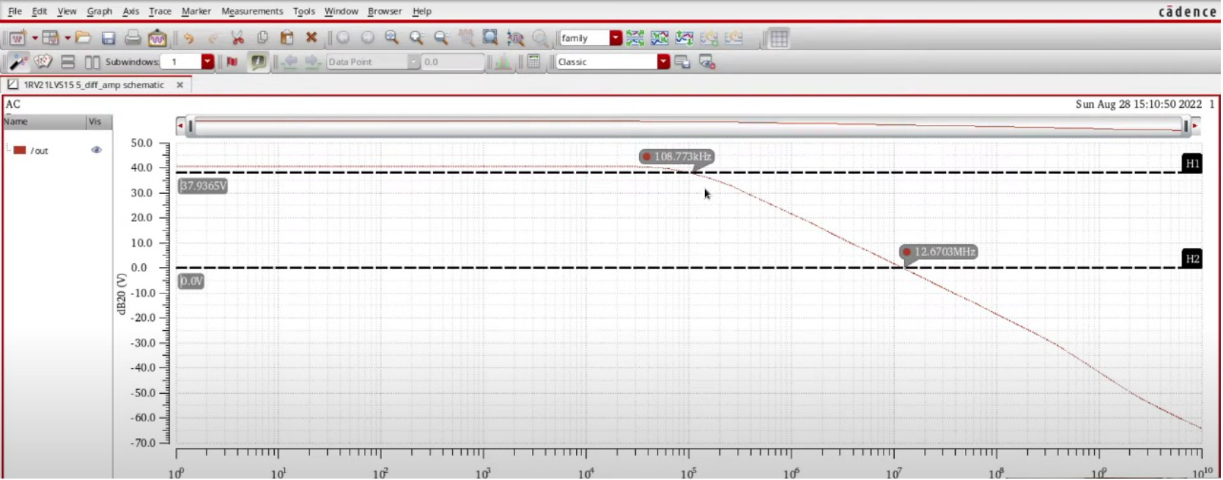
Active Load Circuit
V-F GRAPH OF ACTIVE LOAD DIFFERENTIAL AMPLIFIER

Slide 21
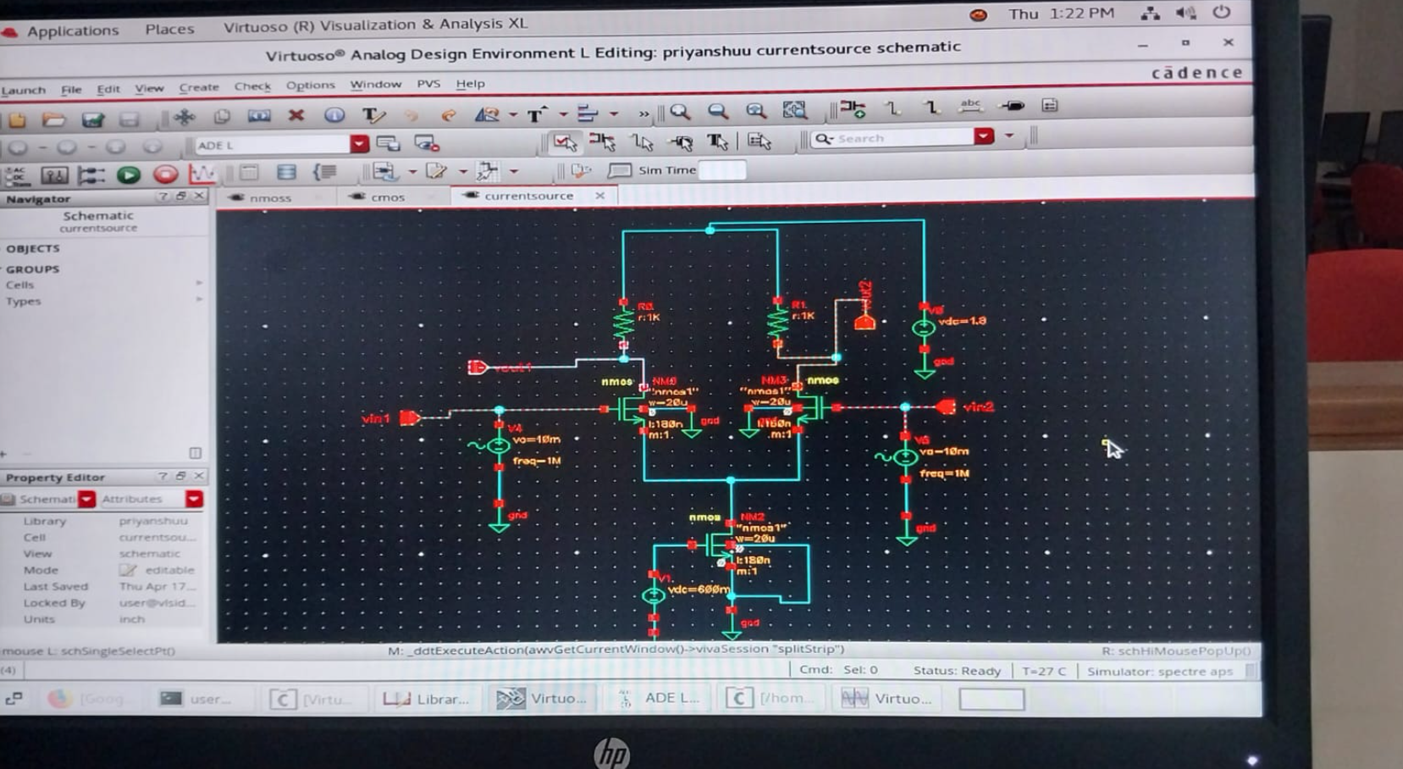
Current source Load Circuit
CIRCUIT DIAGRAM OF CURRENT SOURCE LOAD DIFFERENTIAL AMPLIFIER

Slide 22
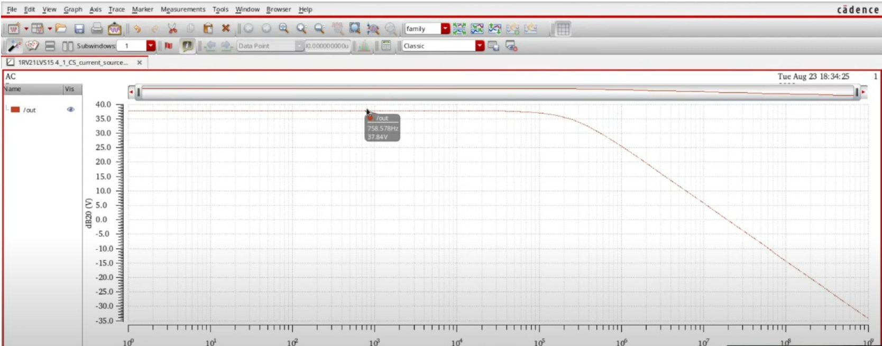
Current source Load Circuit
V-F GRAPH OF Current Source Load DIFFERENTIAL AMPLIFIER

Slide 23
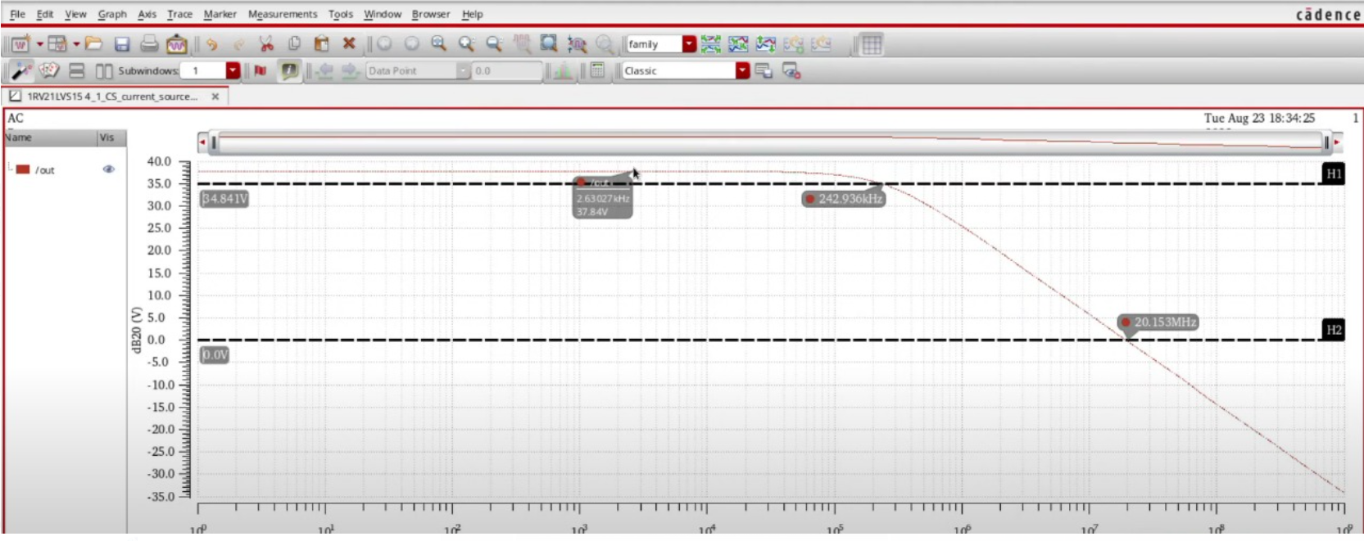
Current source Load Circuit
V-F GRAPH OF Current Source LOAD DIFFERENTIAL AMPLIFIER

Slide 24
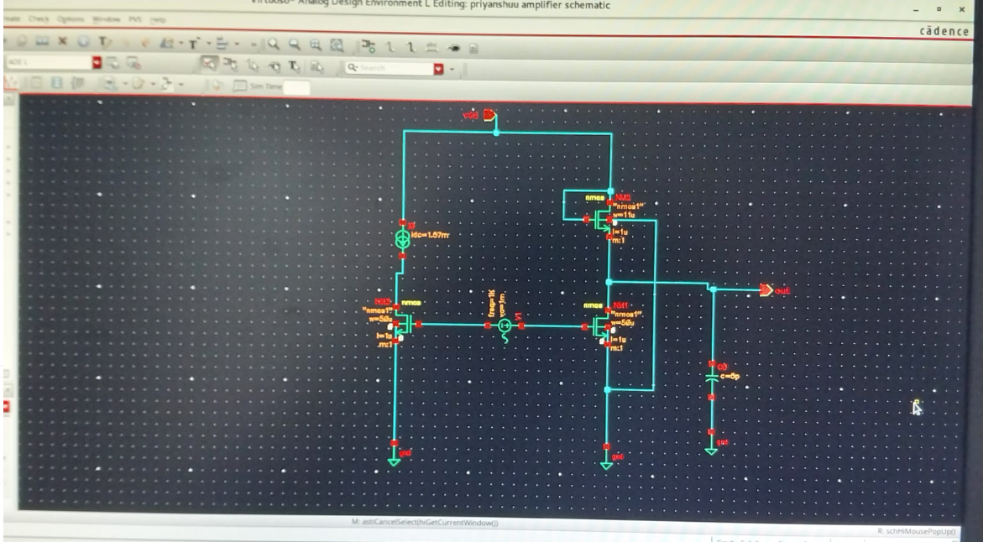
Diode Connected Load Circuit
CIRCUIT DIAGRAM OF Diode Connected Load DIFFERENTIAL AMPLIFIER

Slide 25
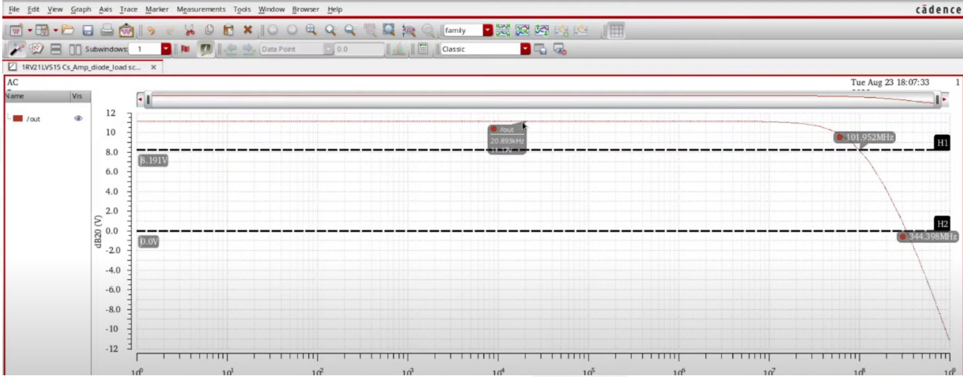
Diode Connected Load Circuit
V-F GRAPH OF Diode Connected Load DIFFERENTIAL AMPLIFIER

Slide 26
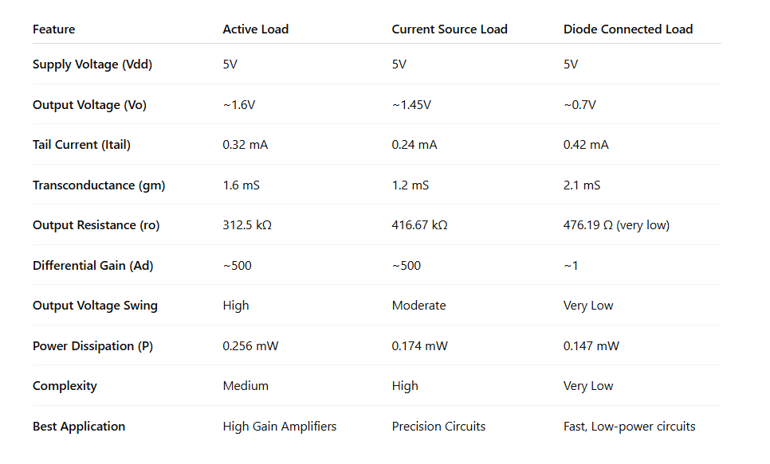
FINAL PARAMETERS COMPARISON TABLE

Slide 27
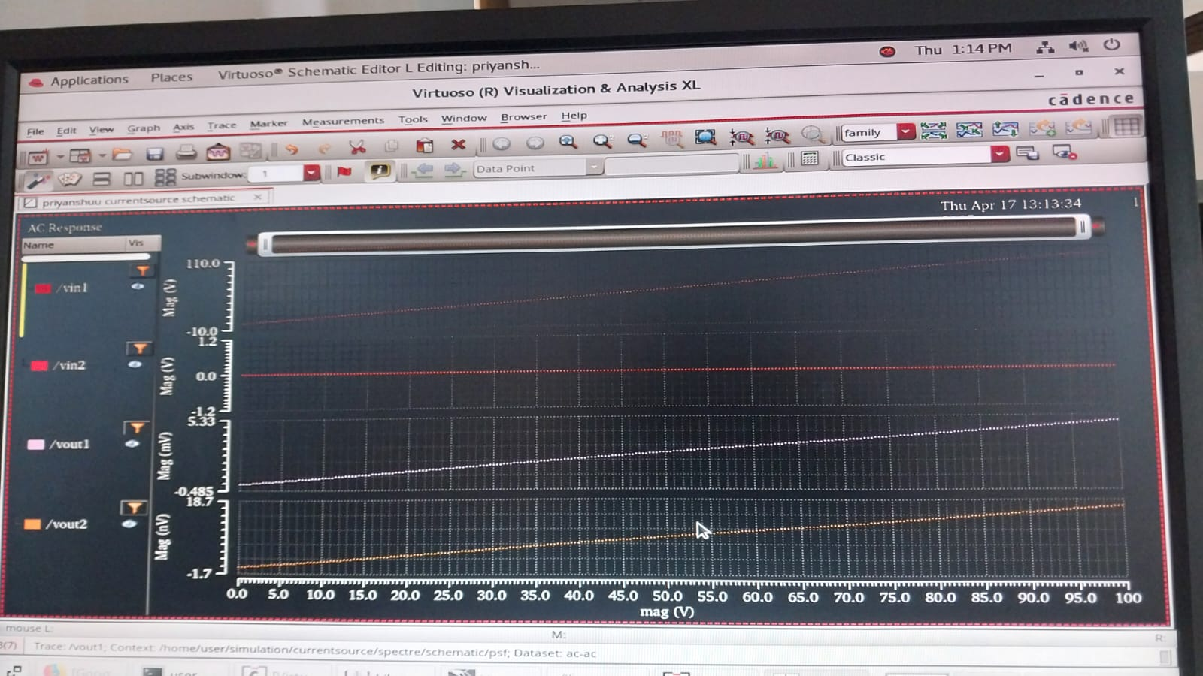
SOME FAILED RESULTS

Slide 28
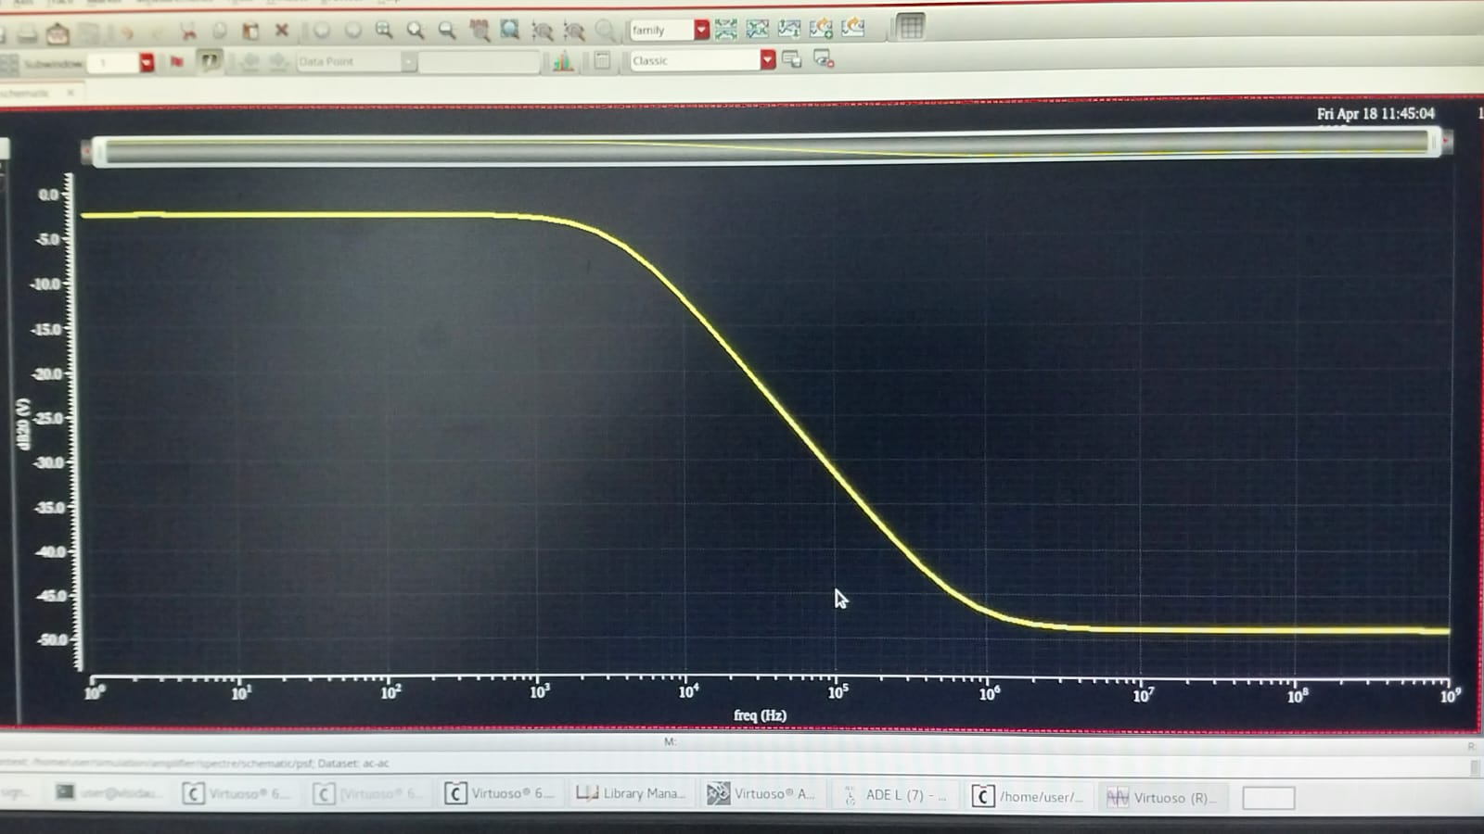
SOME FAILED RESULTS

Slide 29
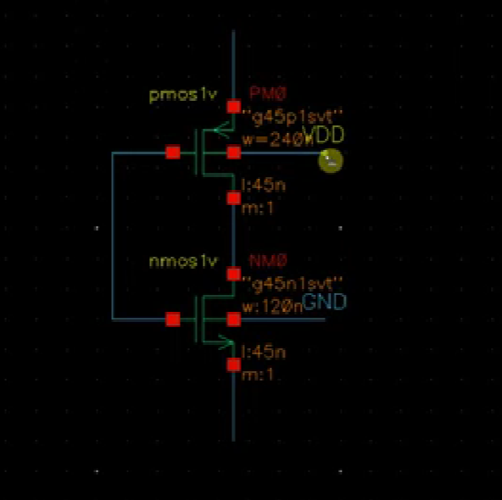
INTRODUCTION TO SOFTWARE
📌 Cadence Virtuoso is a leading EDA tool for analog, digital, and mixed-signal circuit design used in VLSI and CMOS technology. 📌 Enables high-precision simulations for low-power, high-gain circuits like differential amplifiers. 📌 Supports deep-submicron technologies (180nm, 65nm, etc.) and is widely used in sensor circuits, amplifiers, and communication systems.
🔹 Key Features Used in Our Project: ✔ Schematic Editor – Designed the differential amplifier circuit. ✔ Spectre Simulator – Performed DC, AC, and transient analysis. ✔ Virtuoso Layout Suite – Ensured DRC (Design Rule Check) & LVS (Layout vs. Schematic) verification.

Slide 30
Application in Our Project & Advantages
📌 Used Virtuoso to design, simulate, and optimize differential amplifier topologies. 📌 Compared power efficiency, gain, and noise rejection across different designs. 📌 Implemented power-saving techniques while maintaining high gain and performance.
🔹 Why Virtuoso?
✅ Industry-standard for IC design & low-power VLSI applications. ✅ High-accuracy simulations for real-world performance analysis. ✅ Optimized circuit design for better gain and power efficiency.

Slide 31
References
"Design of CMOS Two Stage Op-Amp and Differential Amplifier Using Cadence Virtuoso" – A. Vikas, K. Harini, M. Sripriya, T. Shashank (IJCRT)
"Design and Analysis of High Gain Differential Amplifier Using Various Topologies" – Samarla Shilpa, J. Srilatha (IRJET)
"Two Stage CMOS Operational Amplifier Using Cadence 180nm Technology" – Rakshitha M, Rakshitha Urs S, Shreyas R (IJIRSET)
"Design of High Gain OP-AMP using CMOS with 180nm Technology and its Application using Cadence Virtuoso" – Podila Keerthi, R. Chennakeshavulu (IJEECS)

Slide 32
Conclusion & Future Work
Conclusion
The project successfully optimizes power consumption while maintaining high gain and noise rejection.
CMOS technology & advanced topologies (active load, cascode) improve amplifier performance
Future Work
Exploring Subthreshold Region: Reducing power further using subthreshold operation.
Integration into IoT Systems: Designing ultra-low-power sensors.
Fabrication on 65nm Technology: Reducing area and improving efficiency.

